Slide 1

CEIS150 FINAL
PROGRAMMING WITH OBJECTS
MARK DIBONA

Slide 2
INTRODUCTION
In my final project I will show my proficiency and competence in:
Creating applications in Python
Using object-oriented techniques to develop a stock tracking application
Creating a console and GUI(Graphical User Interface)
Using Python libraries to create charts and get historical stock data from websites

Slide 3
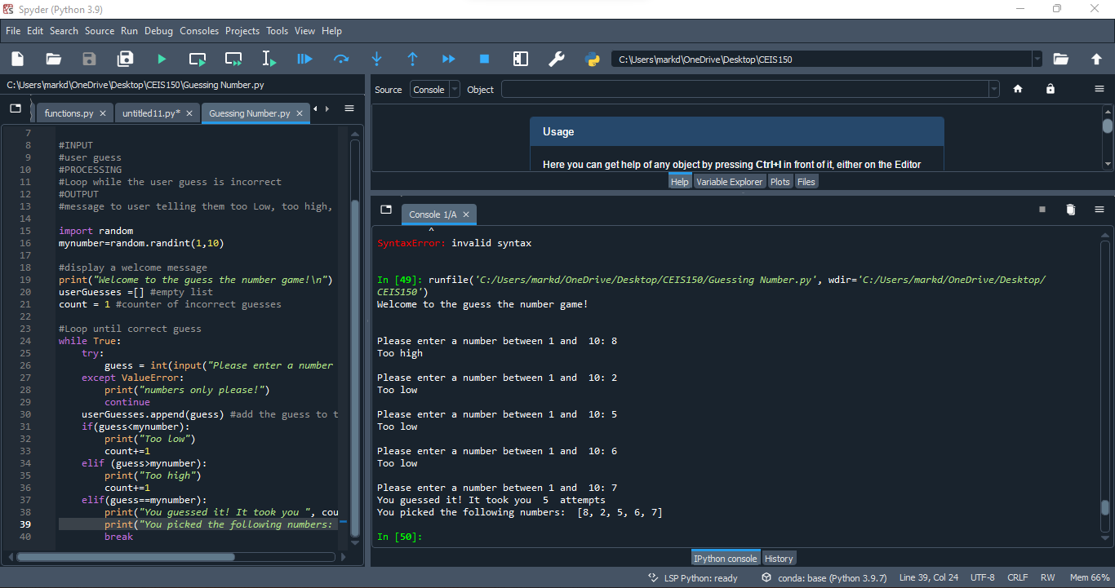
Getting started
In the first part of my project, we had to set up a working environment used to develop the stock tracking applications. This is the screenshot of the python program running successfully.

Slide 4
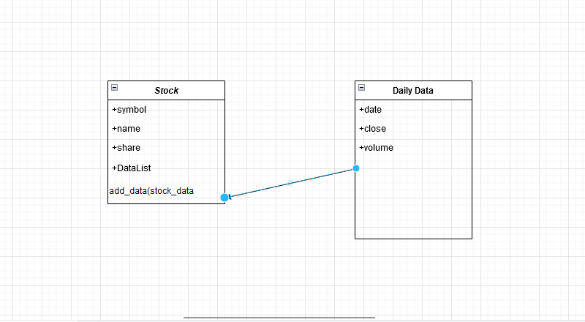
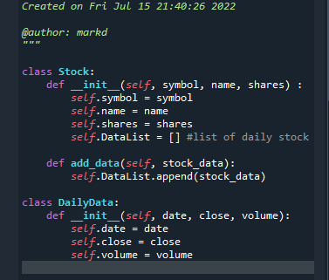
THE NEXT PHASE OF THE PROJECT IS TO FOCUS ON CREATING THE CLASSES NEEDED TO WORK WITH OUR STOCK AND HISTORY DATA
This screenshot shows my Visio class diagram
This screenshot shows my stock_class.py file

Slide 5
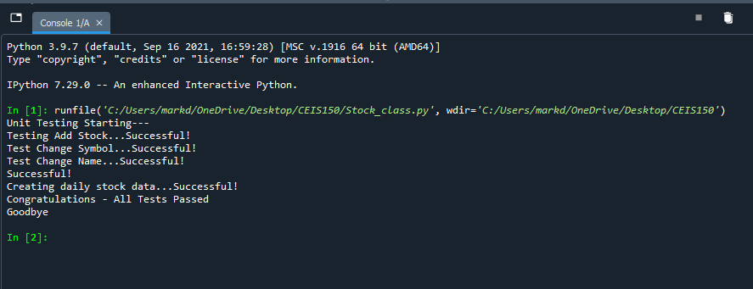
CLASS DIAGRAM AND CODE CONTINUED
This screenshot shows the successful unit test.

Slide 6
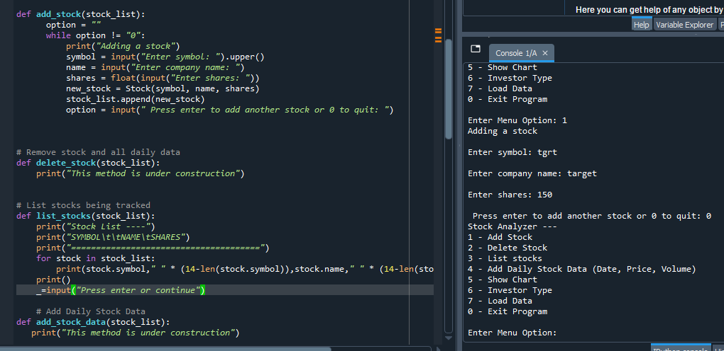
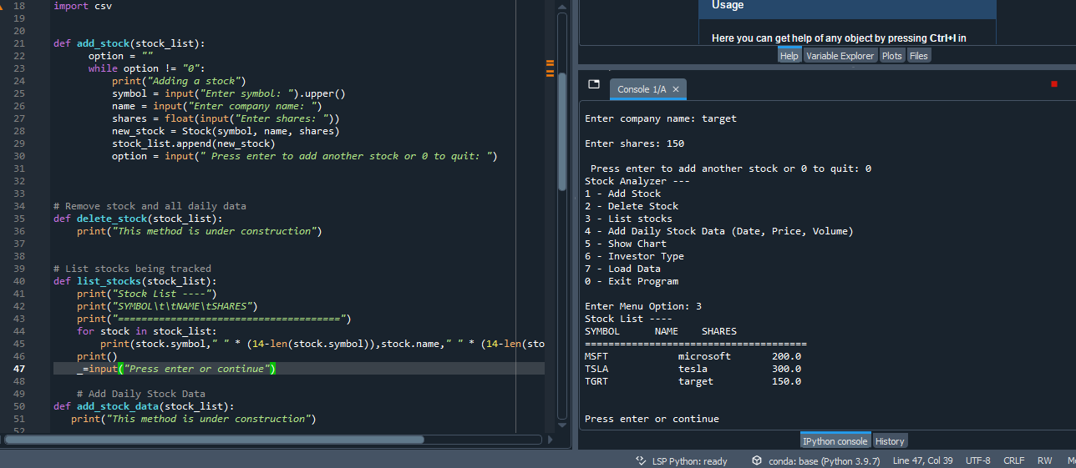
MY NEXT SLIDES WILL SHOW THE SUCCESSFUL CREATION OF A CONSOLE-BASED INTERFACE FOR WORKING WITH STOCK AND THE STOCK PRICE HISTORY
This is a screenshot of stock being added.
This is a screenshot of listing 3 different stocks.

Slide 7
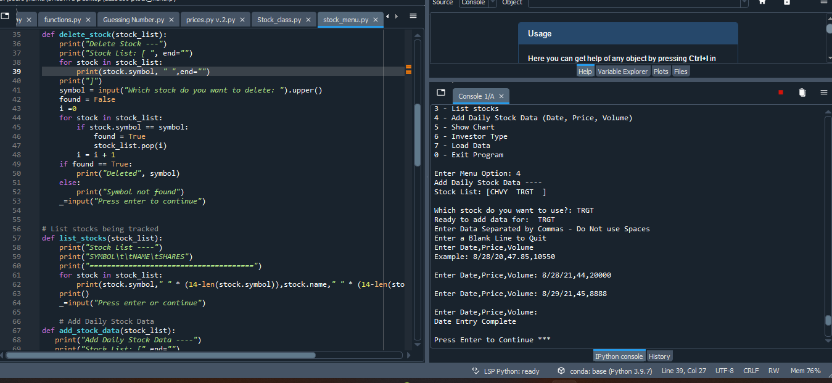
Stock and stock price history continued
This is a screenshot of the daily data.

Slide 8
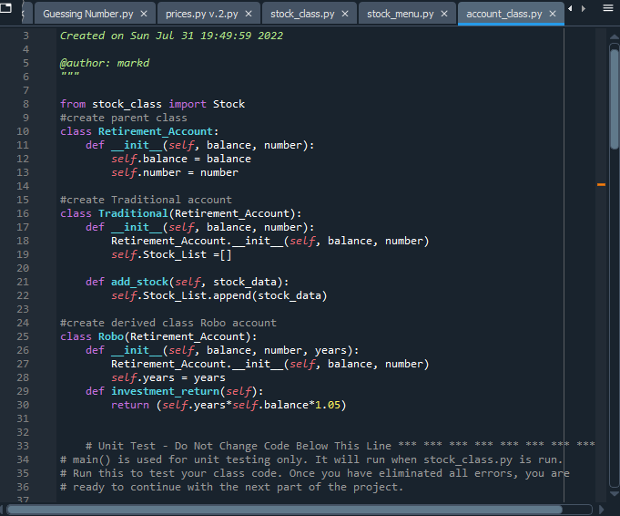
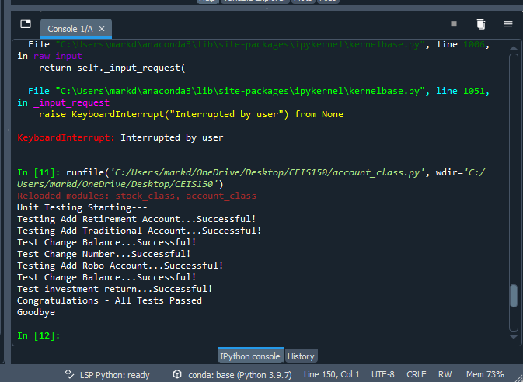
My next slides will focus on creating classes inherited from a base class
This is a screenshot of the Retirement, Traditional, and Robo class
This is a screenshot of the successful unit tests

Slide 9
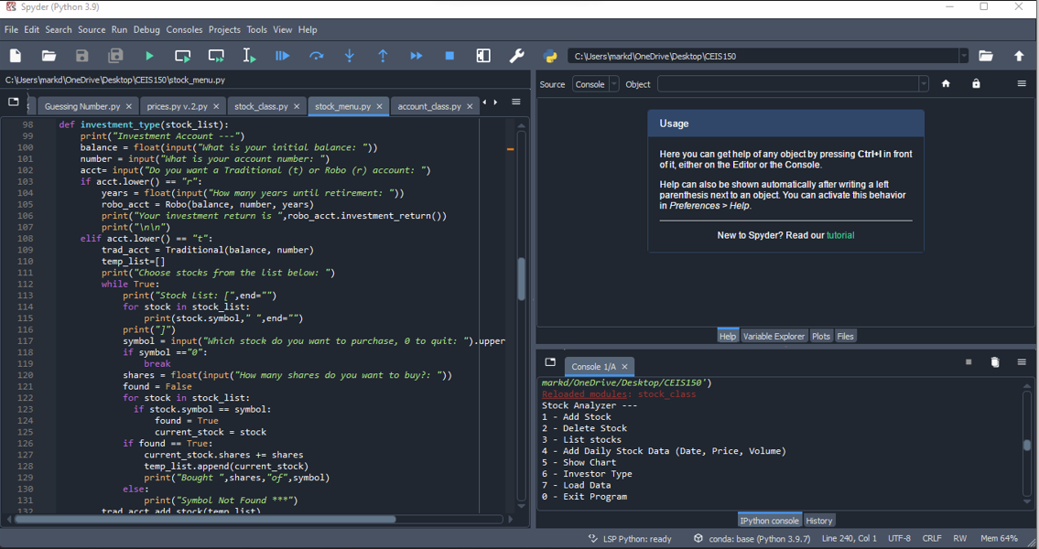
Creating classes continued
This screenshot shows the implementation of the investor type account.

Slide 10
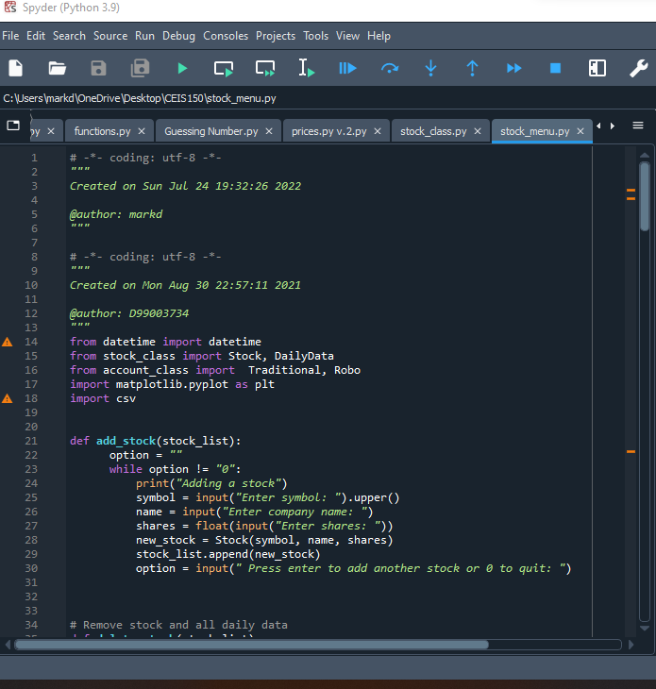
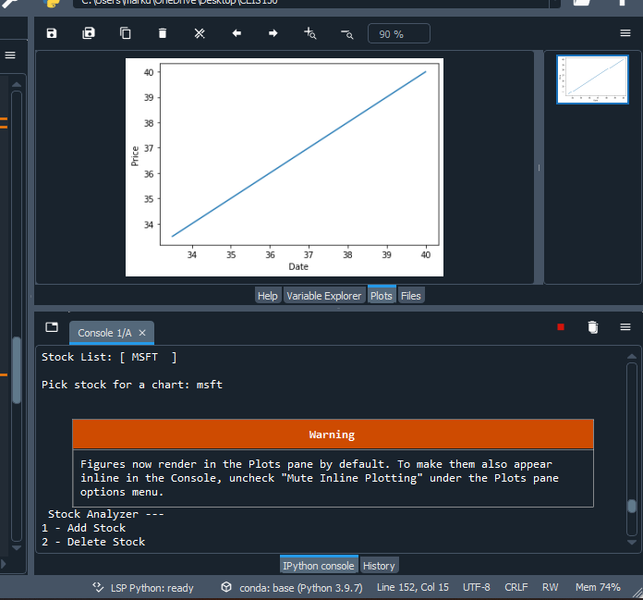
The next part of my project was to focus on using the matplotlib to create a chart showing stock prices over time
My screenshots shows the code along with the stock chart

Slide 11
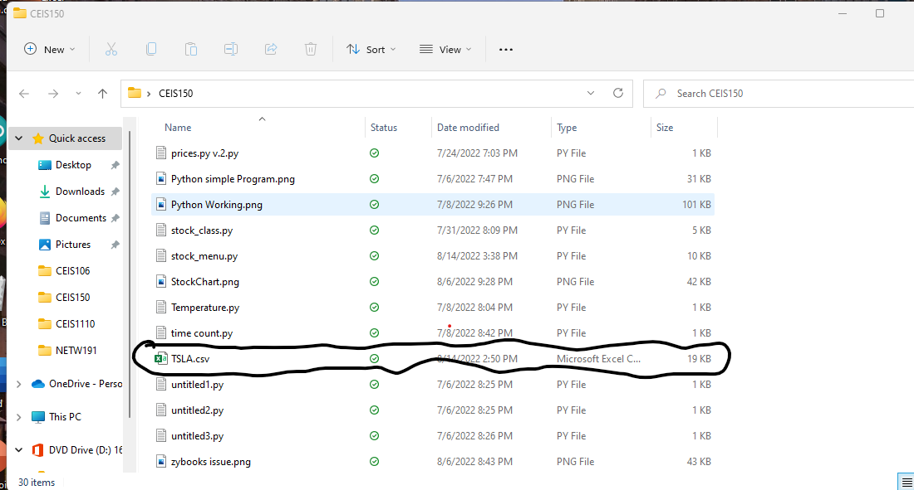
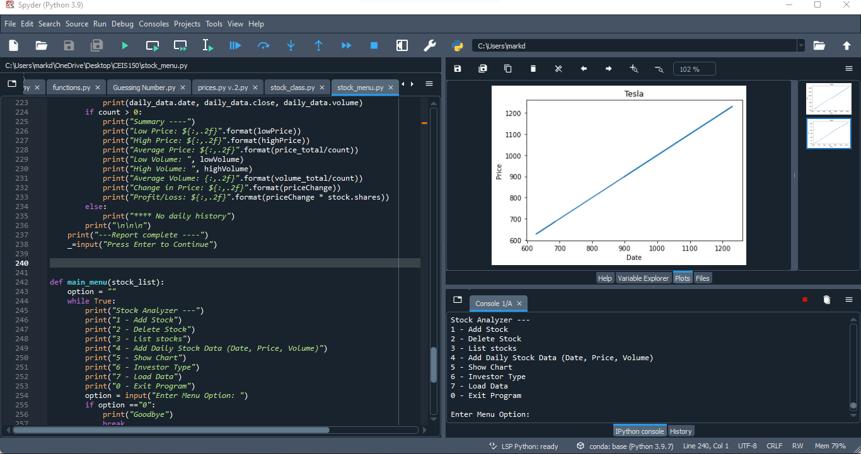
Module 6 of our project focuses on saving data and reading data from files
This screenshot shows the file saved in file explorer.
This screenshot shows the historical data imported.

Slide 12
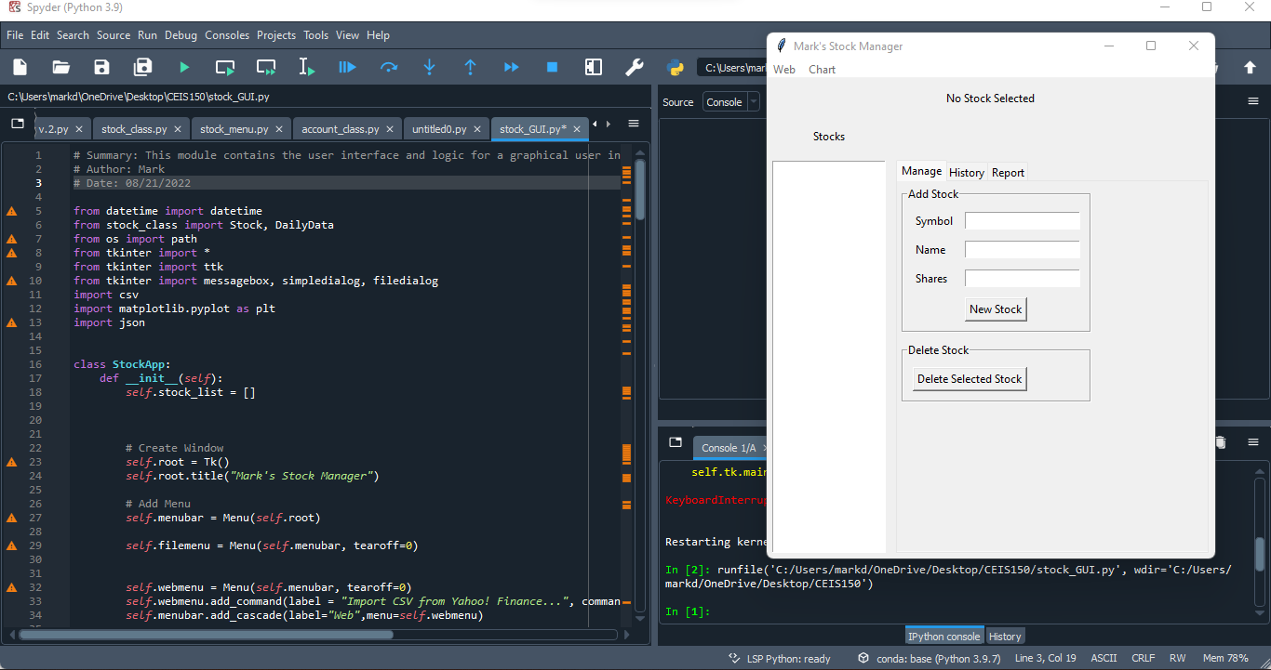
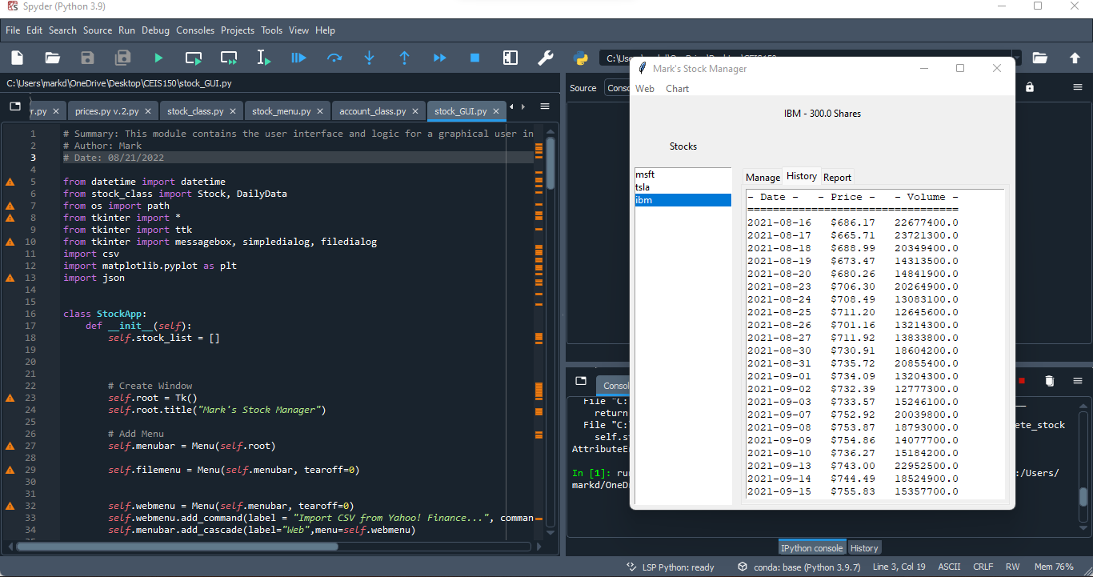
In the final part of our project, we implemented a stock tracking gui project
This screenshot is of my working GUI.
This screenshot is of the History tab with import working.

Slide 13
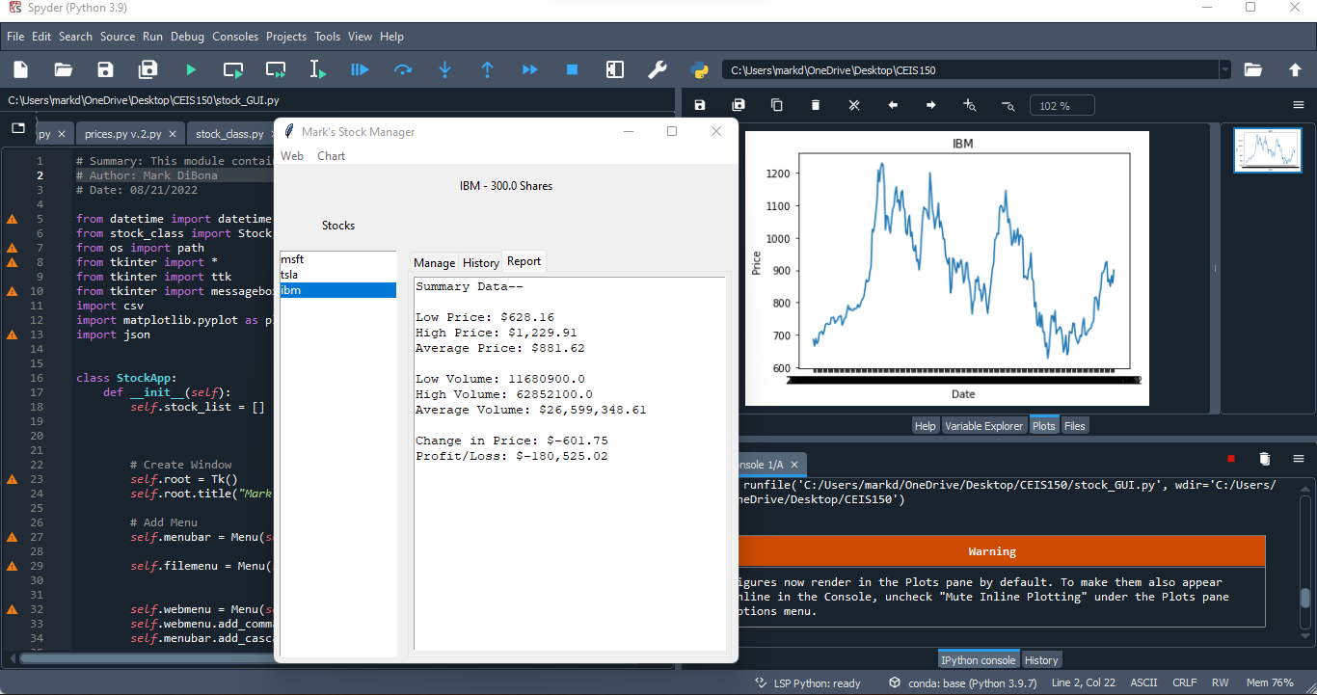
Stock tracking gui project continued
This final screenshot is of my Report tab.

Slide 14
Learning Experiences
There was many things that I have learned from this class, and these are a few of them.
One of the first things that I have come to learn and discover is my excitement for when a code works. It can be frustrated at first when you see that error pop up and then you have to play detective to find it but once you corrected the error it can be sooo much fun.
I am happy to have learned more about programming and coding through Python and being able to understand the Python program more.
My ability to read code has surpassed my expectations. Whenever I would have one of my games that I play crash and I would get an error report I would just look at it puzzled. But now I can understand enough of the error report and be able to problem solve it myself which allows me to continue to play.

Slide 15
Career skills developed
There are many things that I learned that could be used in my future career and these are some of them
Being able to create classes that can be used to work with stocks and history data then creating a console-based interface to work with the stocks and stock price history gives me a blueprint that I can use to help my future company.
Using the process of creating classes inherited from a base class will me help my future company save time and money in coding and programming.
Using the knowledge of implementing a matplotlib to create a chart showing stock prices over time would create and easier to read model that any company could be happy with.

Slide 16
conclusion
I have had some challenges in this course which I was really happy to overcome. Seeing my codes fail and then finding the way to make them work by fixing a mistake made me feel like I was already in a future job of mine. I usually have reservations before starting a class and even more so with this class since there was a prerequisite for this class that I had not taken so I felt a bit nervous. But the amount that I was able to achieve is still something that I cannot believe. There are still some things about myself that I can work on and the more I continue to work hard to get to the future I want the easier those things will be to work on.
Thank you, Professor Baxi!

